Slide 1
JavaFX Basics

Slide 2
What is JavaFX?
JavaFX is a new framework for developing Java GUI programs.
JavaFX is similar to Adobe Flash or Microsoft Silverlight.
The difference? JavaFX is platform-independent.
Because JavaFX is fully integrated with the Java Runtime, any device that can run Java can also serve up the JavaFX experience.

Slide 3
Start
Download and install IntelliJ and Scenebuilder according to the tutorials
Create a new project in JavaFX

Slide 4
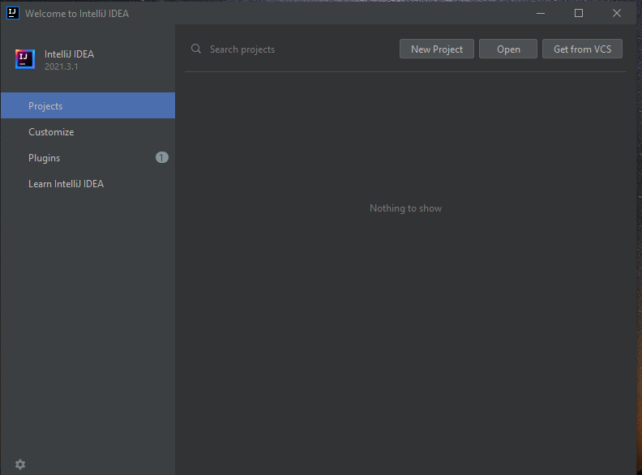
Start a New Project
This is the IntelliJ start screen. To create a new Project,
click New Project.

Slide 5
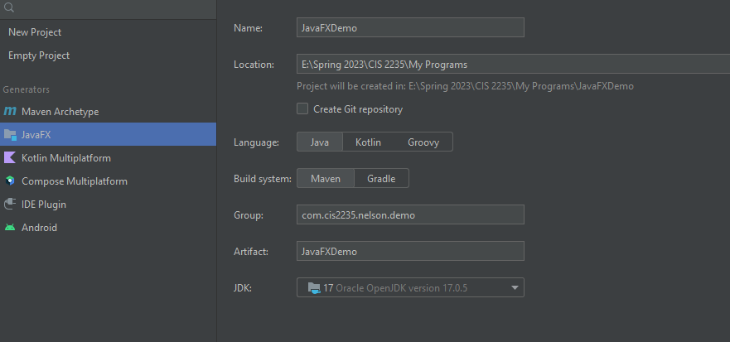

Select JavaFX, name it JavaFXDemo,and browse to the location you prefer. Change the Group to com.cis2235.lastname.demo. No caps. Press the Next button at bottom right.

Slide 6

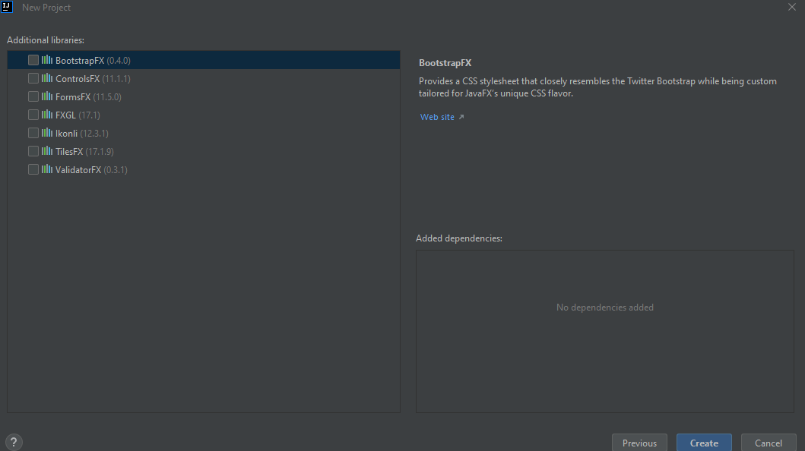

Select Additional Libraries, although these are additional and you don’t need them for our projects, then click Create.

Slide 7
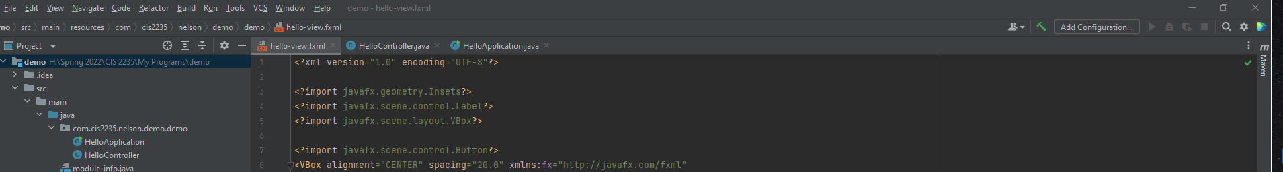
Build your program
You can click on the hammer and build your project:

Slide 8
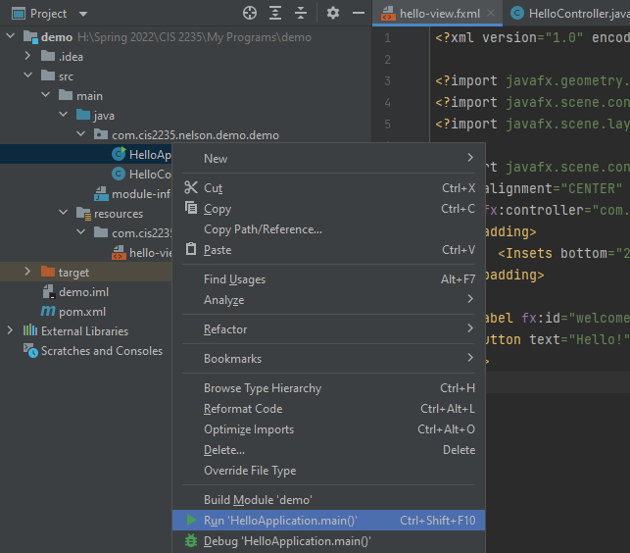
Run your Program
Right-click on HelloApplication.java (contains main) and select Run ‘HelloApplication.main()’

Slide 9
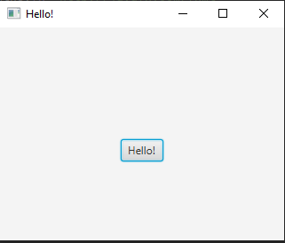
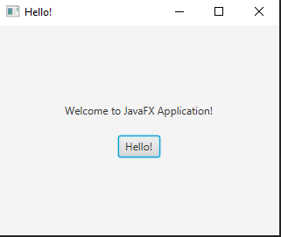
To get: Hello! Press the Hello! Button to get:

Slide 10
Open the Project: FirstApplication – Hello!
Open the Project: FirstApplication – Hello!
At the left, under src > main > java, the package is com.cis2235.nelson.demo.javafxdemo
javafxdemo is the name I chose for my project. If you click on the triangle, you will see three files:
HelloApplication
HelloController
module-info.java
Under java, you will also see resources. Click it open to fine hello-view.fxml.

Slide 11
HelloApplication.java Class
HelloApplication.java Class
When you look at this class, you will see:
package com.cis2235.nelson.demo.javafxdemo;
//The imports
import javafx.application.Application;
import javafx.fxml.FXMLLoader;
import javafx.scene.Scene;
import javafx.stage.Stage;
import java.io.IOException;
//The package

Slide 12
The HelloApplication Class
The HelloApplication Class
Each JavaFX class extends Application.
It also contains the main method and the start() method.
The main() method contains only a call to launch();

Slide 13
The launch( ) method
The launch( ) method
looks for your Main class
ensures that it extends Application
attempts to call the start( ) method, which Main inherits from Application
Main must override the start( ) method to execute any code you want to run.
The launch( ) method

Slide 14
In JavaFX, all the world’s a stage!
In JavaFX, all the world’s a stage!
All JavaFX applications are built on a Stage.
It is the foundation for the rest of the application’s objects.

Slide 15
The start(Stage stage ) method
The start(Stage stage ) method
The file hello-view.fxml is loaded
The scene is set on the stage.
The stage is shown to the world.
The stage is a window that can display scenes that contain nodes.
The Stage forms the Window’s outer frame and provides standard Windows features.

Slide 16
The Scene Class
The Scene Class
The Scene class holds a container for organizing multiple components that are displayed on the Stage.
The Scene is a compositional tree, also called a scene graph.
The root of the scene is the container that holds the components.

Slide 17
Nodes
Nodes
The most general type of thing you can put into a Scene is a Node.
The components are all Nodes.

Slide 18
What is FXML?
What is FXML?
FXML is a user interface markup language based on XML.
It is a great language for creating easy, quick, and flexible UI’s.

Slide 19
The hello-view.fxml File
<?xml version= "1.0" encoding= "UTF-8"?>
import javafx.geometry.Insets?> <?import javafx.scene.layout.VBox?> <?import javafx.scene.control.Button?> <?import javafx.scene.control.Label?> <Vbox fx:controller= "com.cis2235.nelson.demo. HelloController" xmlns:fx="http://javafx.com/fxml"
alignment="CENTER" spacing="20">
<padding>
<Insets bottom= "20.0" left= "20.0" right= "20.0" top= "20.0 " />
</padding>
<Label fx:id= "welcomeText " />
<Button text= "Hello!" onAction= "#onHelloButtonClick " /> </VBox>

Slide 20
VBox
It provides a 3X1 grid layout.
You can change it in Scenebuilder
The VBox is a handy layout manager for the window.
The VBox is a handy layout manager for the window.
<VBox fx:controller="com.cis2235.nelson.demo.HelloController" xmlns:fx="http://javafx.com/fxml"
alignment="spacing ="20"> </VBox>

Slide 21
public class HelloController {}
public class HelloController {}
The HelloController file Initially displays the label and an event handler to set text in the label when the button is pushed. We won’t need this code.
The controller class may implement the Initializable interface, which provides one method:
public void initialize(URL url, ResourceBundle rb)
This is where you will code the logic and event handlers for running the program

Slide 22
Model-View Controller
Model-View Controller
JavaFX is designed to implement MVC:
Controllers: activities which connect the Views to the Models with logic. They include event handlers.
Views: the user interface, They are provided in fxml layouts, and may include menus, scrollable lists and widgets like buttons
Models: the raw information or access to the raw information (our Java classes)

Slide 23
Why use MVC?
Why use MVC?
This pattern decouples changes to how data are manipulated from how they are displayed or stored, while unifying the code in each component.
In other words, it's a way of developing apps keeping the data (model) used in the program, and the visual (view) component of the program separate from one another, each interacting only with a controller containing the logic of our program.
The view and the model interact only with the controller NEVER with each other.

Slide 24
Basic Structure of JavaFX
Application
Override the start(Stage) method
Stage, Scene, and Nodes

Slide 25
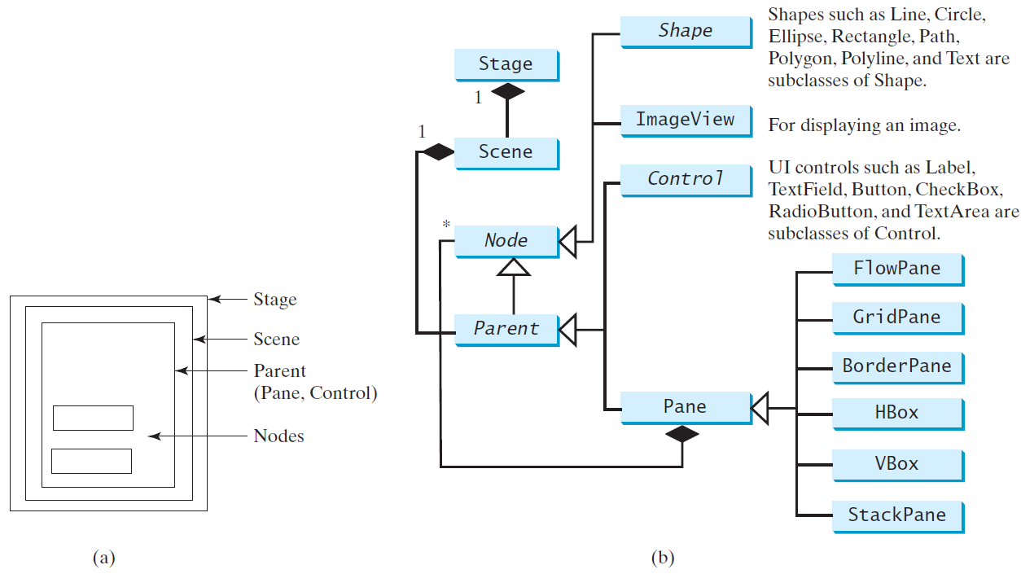
Panes, UI Controls, and Shapes

Slide 26
Be careful with imports!
JavaFX uses its own classes instead of AWT or Swing!
This means if you are being offered multiple choices for an import , be sure to select the fx version!

Slide 27
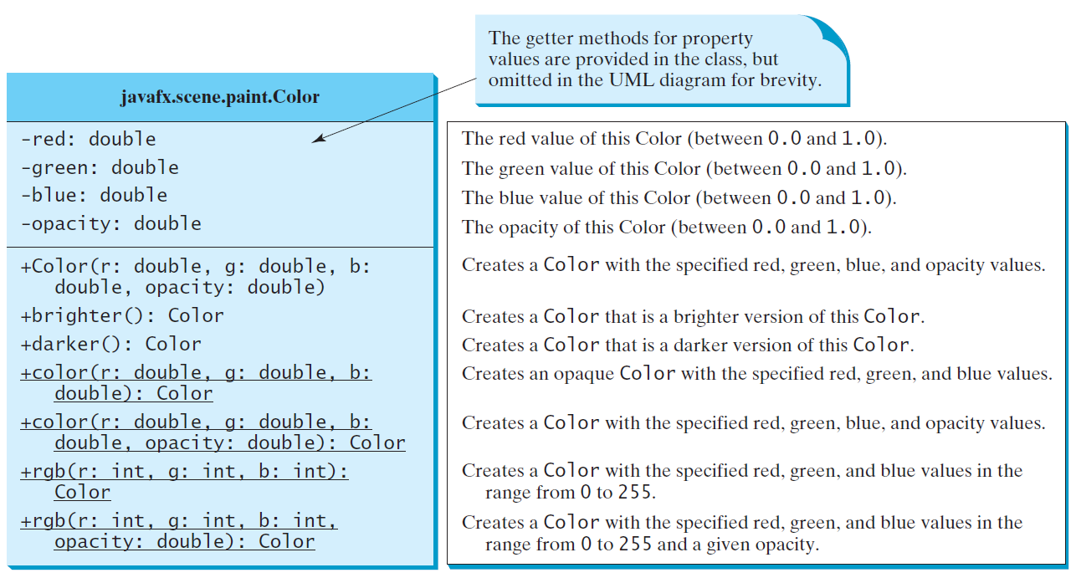
The Color Class

Slide 28
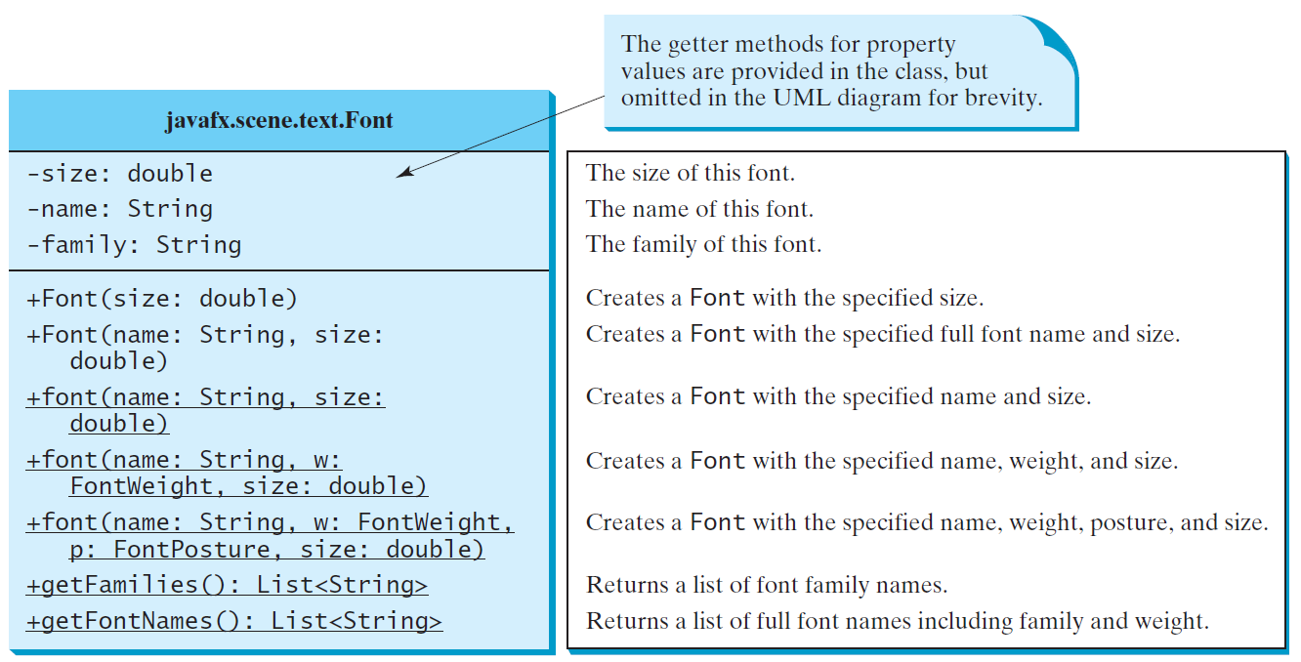
The Font Class

Slide 29
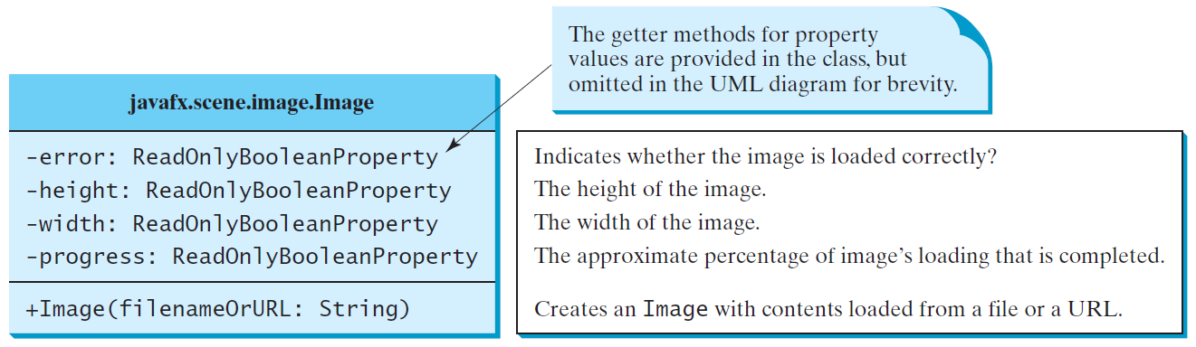
The Image Class

Slide 30
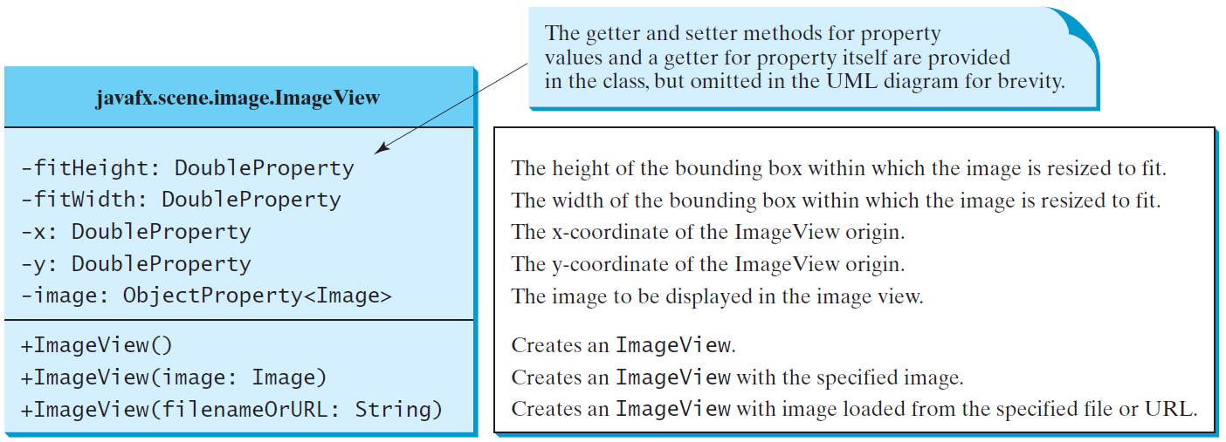
The ImageView Class

Slide 31
LAYOUT PANES

Slide 32
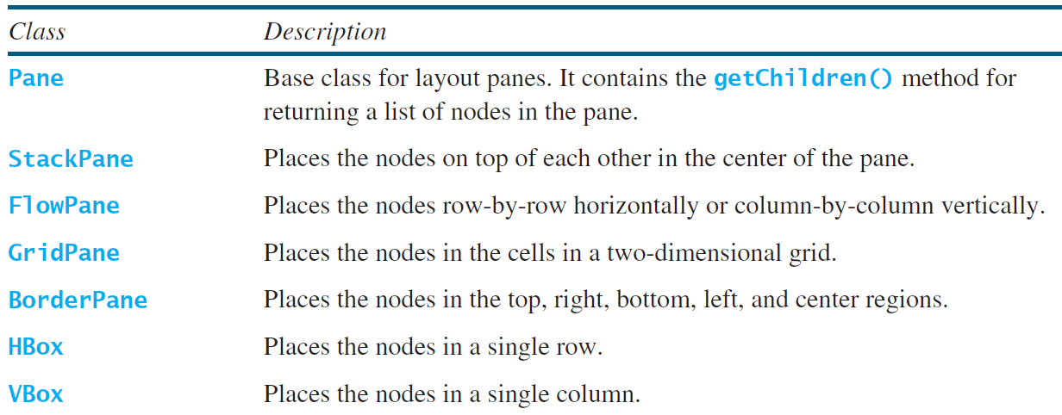
JavaFX Layout Panes

Slide 33
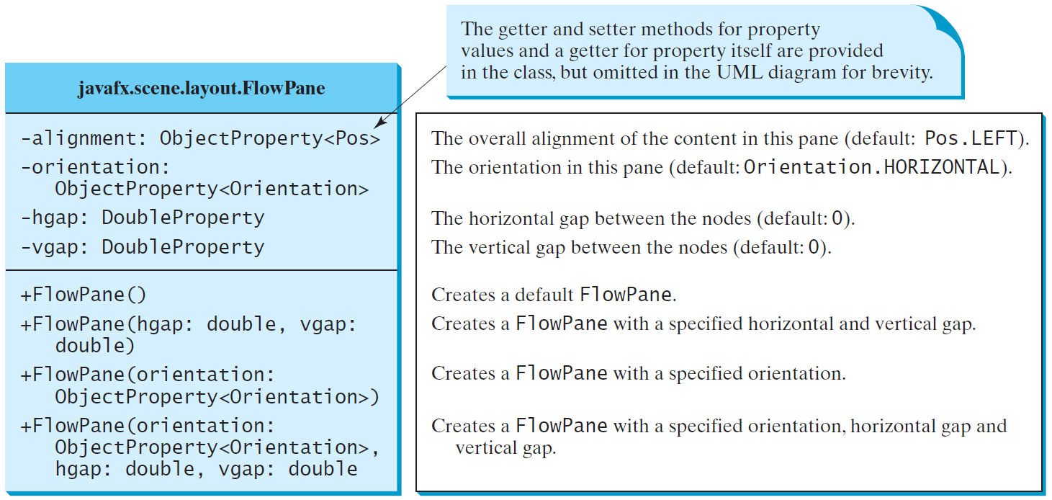
FlowPane

Slide 34
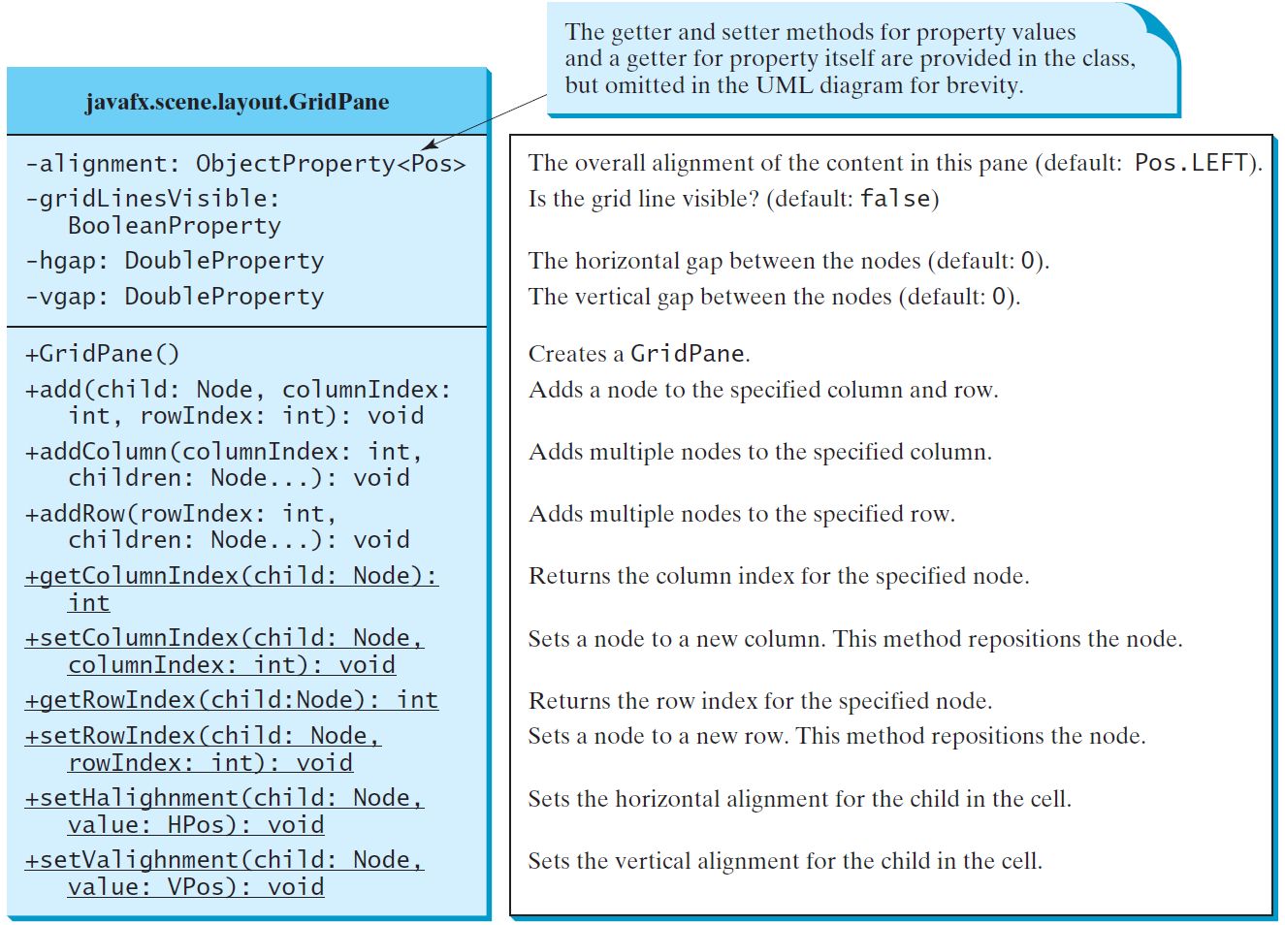
GridPane

Slide 35
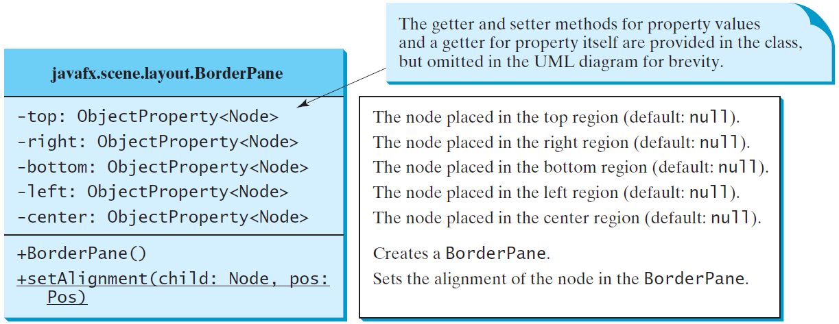
BorderPane

Slide 36
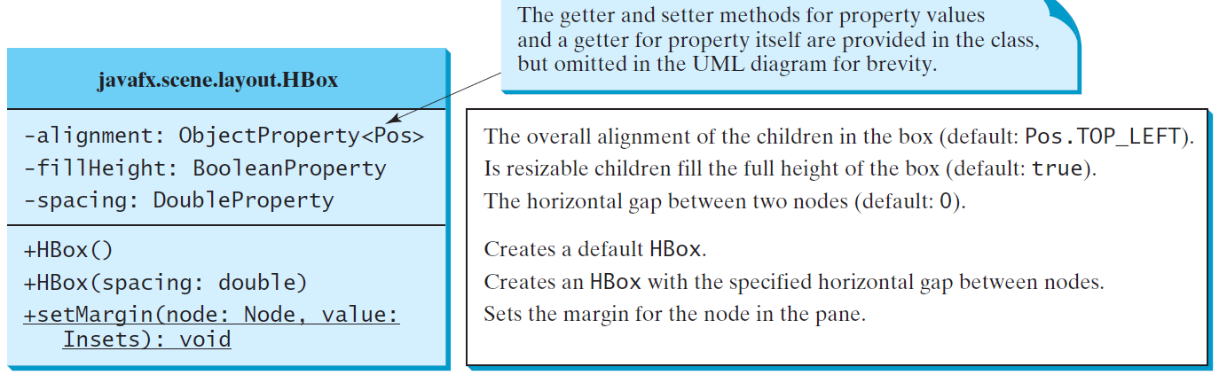
Hbox

Slide 37
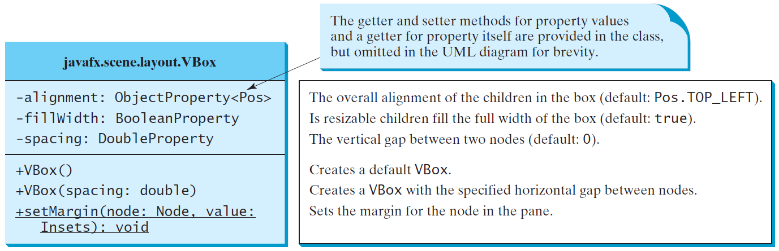
VBox

Slide 38
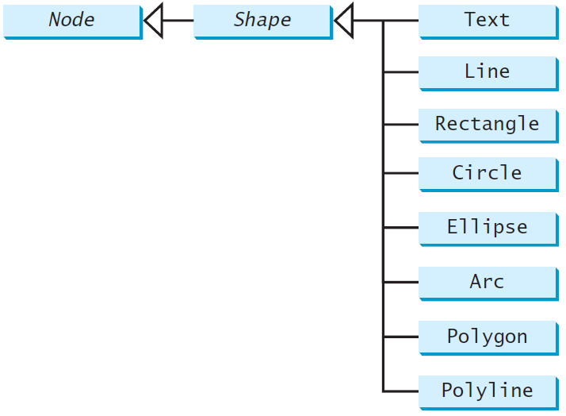
Shapes
JavaFX provides many
shape classes for drawing
texts, lines, circles, rectangles,
ellipses, arcs, polygons, and polylines.

Slide 39
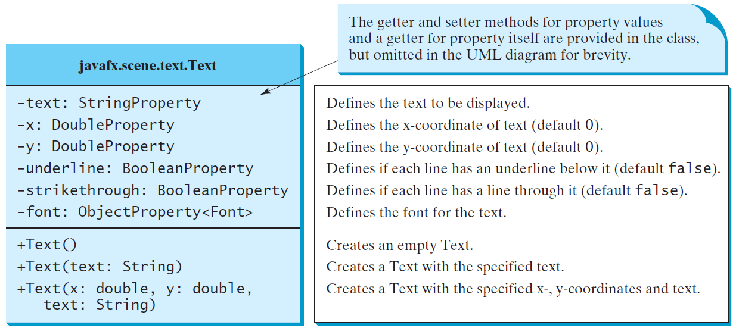
Text

Slide 40
JavaFX Shapes

Slide 41
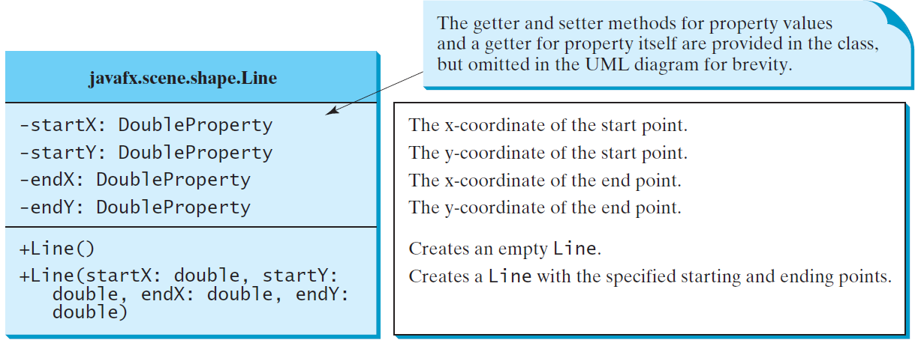
Line

Slide 42
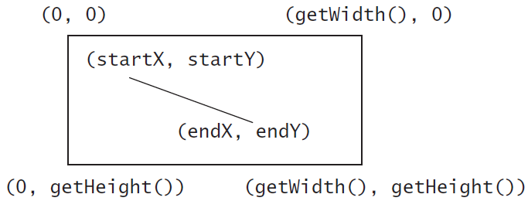
Line Example

Slide 43
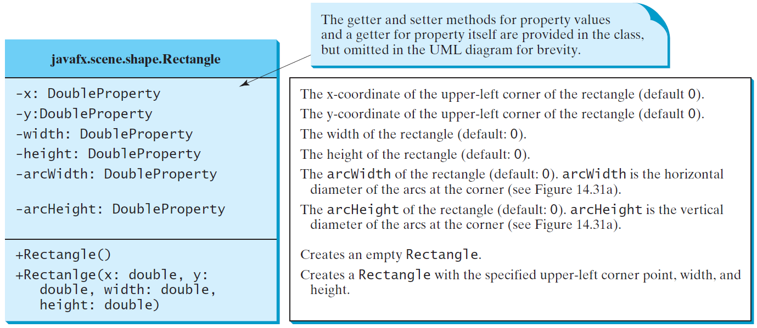
Rectangle

Slide 44
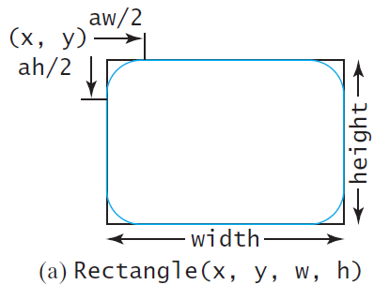
Rectangle Example

Slide 45
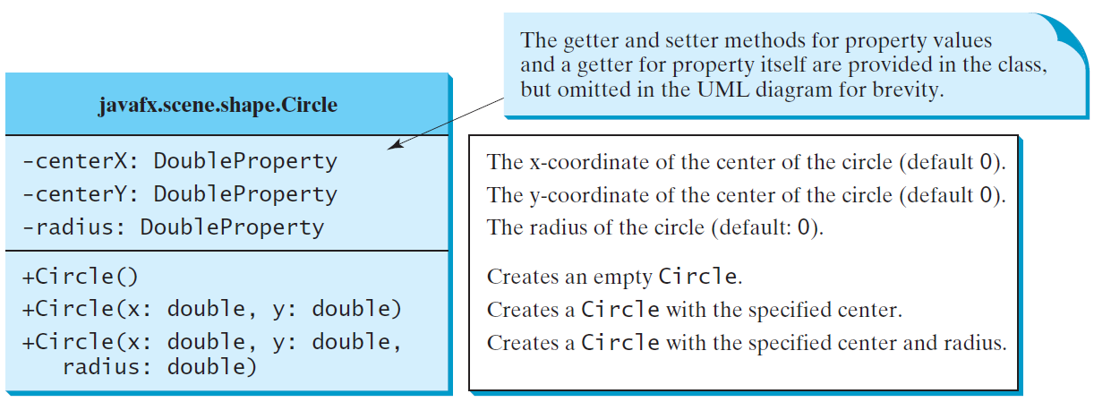
Circle

Slide 46
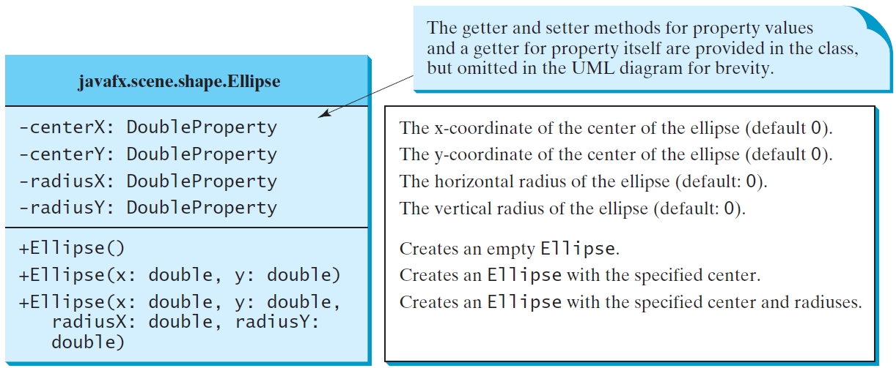
Ellipse

Slide 47
Example of Ellipse

Slide 48
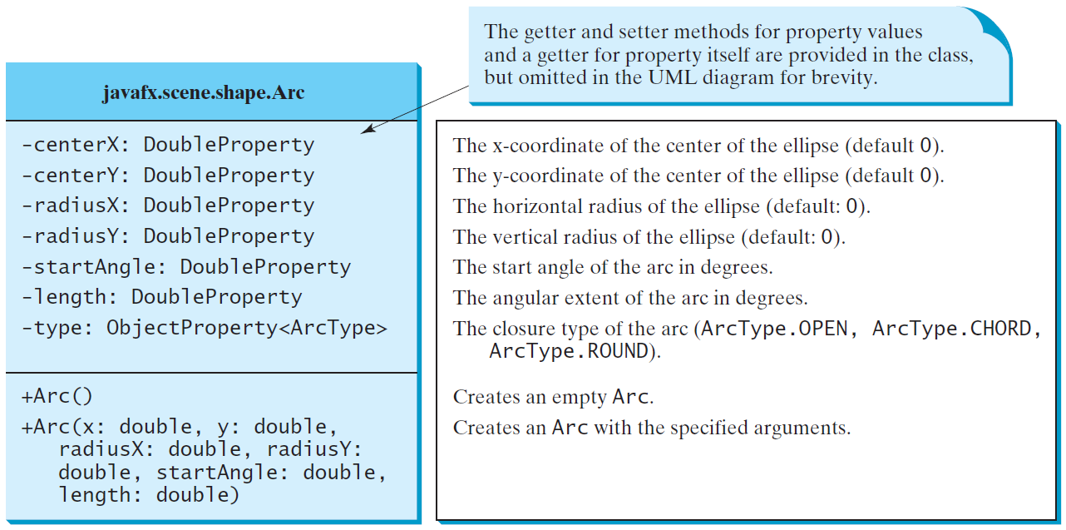
Arc

Slide 49
Arc Examples

Slide 50
Polygon and Polyline

